Slide 1
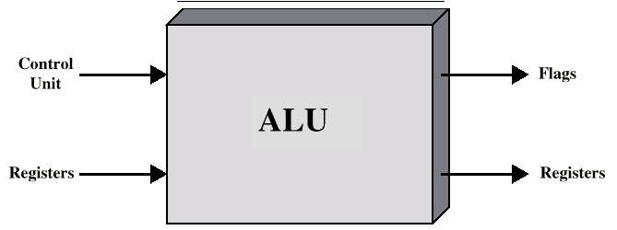
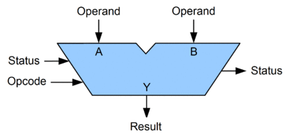
ALU
An arithmetic logic unit (ALU) is a combinational digital electronic circuit that performs arithmetic and bitwise logical operations on integer binary numbers.
Other types floating-point unit (FPU), which operates on floating point numbers and graphics processing units(GPUs).
A single CPU, FPU or GPU may contain multiple ALUs.

Slide 2
The inputs to an ALU are the data to be operated on, called operands, and a code indicating the operation to be performed;
the ALU's output is the result of the performed operation.
, the ALU also exchanges additional information with a status register, which relates to the result of the current or previous operations.

Slide 3
Arithmetic operations
Add: A and B are summed and the sum appears at Y and carry-out.
Add with carry: A, B and carry-in are summed and the sum appears at Y and carry-out.
Subtract: B is subtracted from A (or vice-versa) and the difference appears at Y and carry-out. For this function, carry-out is effectively a "borrow" indicator.
Subtract with borrow: B is subtracted from A (or vice-versa) with borrow (carry-in) and the difference appears at Y and carry-out (borrow out).
Two's complement (negate):
Increment: A (or B) is increased by one and the resulting value appears at Y.
Decrement: A (or B) is decreased by one and the resulting value appears at Y.

Slide 4
Bitwise logical operations
AND: the bitwise AND of A and B appears at Y.
OR: the bitwise OR of A and B appears at Y.
Exclusive-OR: the bitwise XOR of A and B appears at Y.
NOT: all bits of A (or B) are inverted and appear at Y.

Slide 5
Bit shift operations
ALU shift operations cause operand A (or B) to shift left or right (depending on the opcode) and the shifted operand appears at Y.
Arithmetic shift: the operand is treated as a two's complement integer, meaning that the most significant bit is a "sign" bit and is preserved.
Logical shift: a logic zero is shifted into the operand. This is used to shift unsigned integers.
Rotate: the operand is treated as a circular buffer of bits so its least and most significant bits are effectively adjacent.

Slide 6
